Slide 1
Simulation of Reactive Distillation Column
Name : a.k. gokul Raman
Discipline : chemical engineering
Supervisor : prof. nitin padhiyar

Slide 2
Content
Reactive Distillation
Mass and Energy Balance
Pre Mid – Semester Assumptions
Post Mid – Semester Work
Modified Raoult’s law
Temperature Profile
Results
Future Prospects

Slide 3
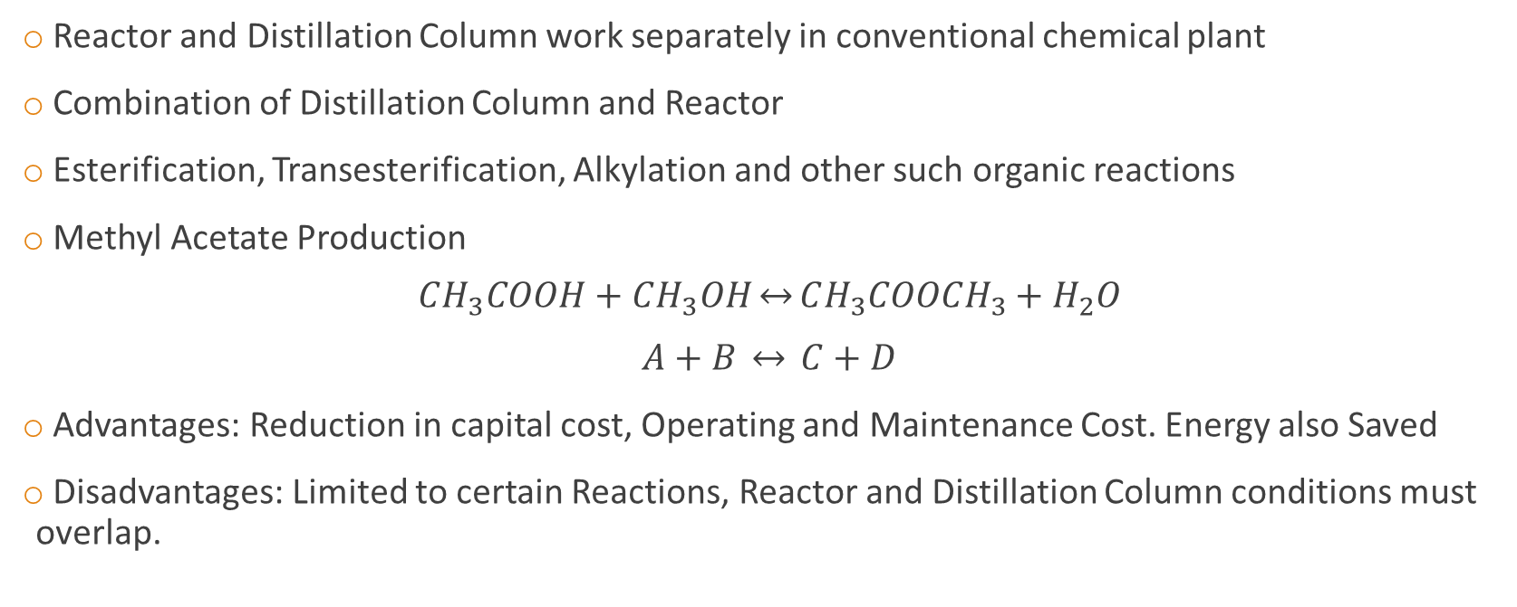
Reactive Distillation(RD)
Reactor and Distillation Column work separately in conventional chemical plant
Combination of Distillation Column and Reactor
Esterification, Transesterification, Alkylation and other such organic reactions
Methyl Acetate Production $CH_{3}COOH+CH_{3}OH\underset{↔}{}CH_{3}COOCH_{3}+H_{2}O$
$$A+B \underset{↔}{} C+D$$
Advantages: Reduction in capital cost, Operating and Maintenance Cost. Energy also Saved
Disadvantages: Limited to certain Reactions, Reactor and Distillation Column conditions must overlap.

Slide 4
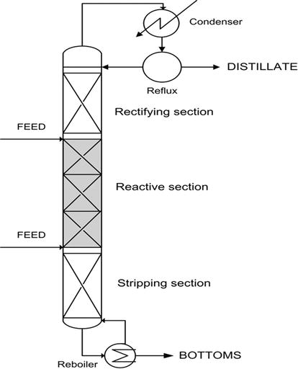
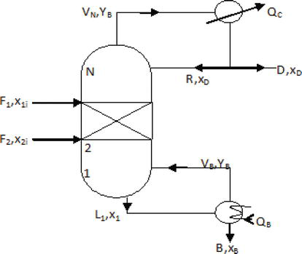

Slide 5


Nomenclature
$$∆H_{v}−Total Heat of Vaporisation$$
$$D−Distillate Flow Rate$$
$$B −Bottoms Flow Rate$$
$$y_{n,j}−Vapor composition of n^{th}stage$$
$$RR−Reflux Ratio$$
$$F_{n}−Feed flow rate on n^{th}stage$$
$$z_{n,j}−Feed COmposition on n^{th}stage$$
$$NT −Total number of stages$$
$v_{j} −Stoichiometric Coefficient$
$R_{n,j}−Reaction rate on n^{th}stage$
$M_{n}−Liquid Holdup on n^{th}stage$
$k_{Fn}−Forward Reaction rate on n^{th}stage$
$k_{Bn}−Backward Reaction rate on n^{th}stage$
$x_{n,j}−liquid composition on n^{th} stage$
$V_{n}−Flow rate of vapor on n^{th}stage$
$L_{n}−Flow rate of liquid on n^{th}stage$

Slide 6
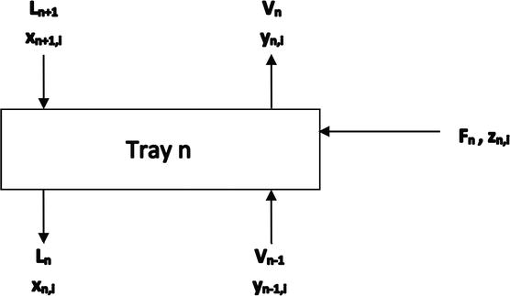
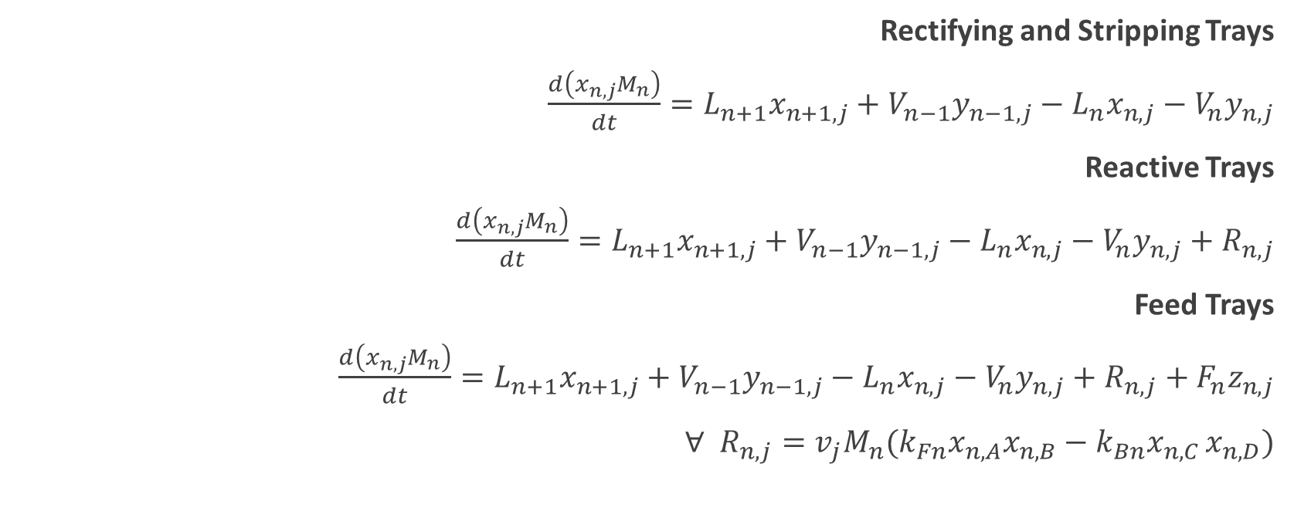
Mass and Energy Balance
Rectifying and Stripping Trays
$\frac{d\left(x_{n,j}M_{n}\right)}{dt}=L_{n+1}x_{n+1,j}+V_{n−1}y_{n−1,j}−L_{n}x_{n,j}−V_{n}y_{n,j}$
Reactive Trays
$\frac{d\left(x_{n,j}M_{n}\right)}{dt}=L_{n+1}x_{n+1,j}+V_{n−1}y_{n−1,j}−L_{n}x_{n,j}−V_{n}y_{n,j}+R_{n,j}$
Feed Trays
$\frac{d\left(x_{n,j}M_{n}\right)}{dt}=L_{n+1}x_{n+1,j}+V_{n−1}y_{n−1,j}−L_{n}x_{n,j}−V_{n}y_{n,j}+R_{n,j}+F_{n}z_{n,j}$
$∀ R_{n,j}=v_{j}M_{n}(k_{Fn}x_{n,A}x_{n,B}−k_{Bn}x_{n,C }x_{n,D})$

Slide 7
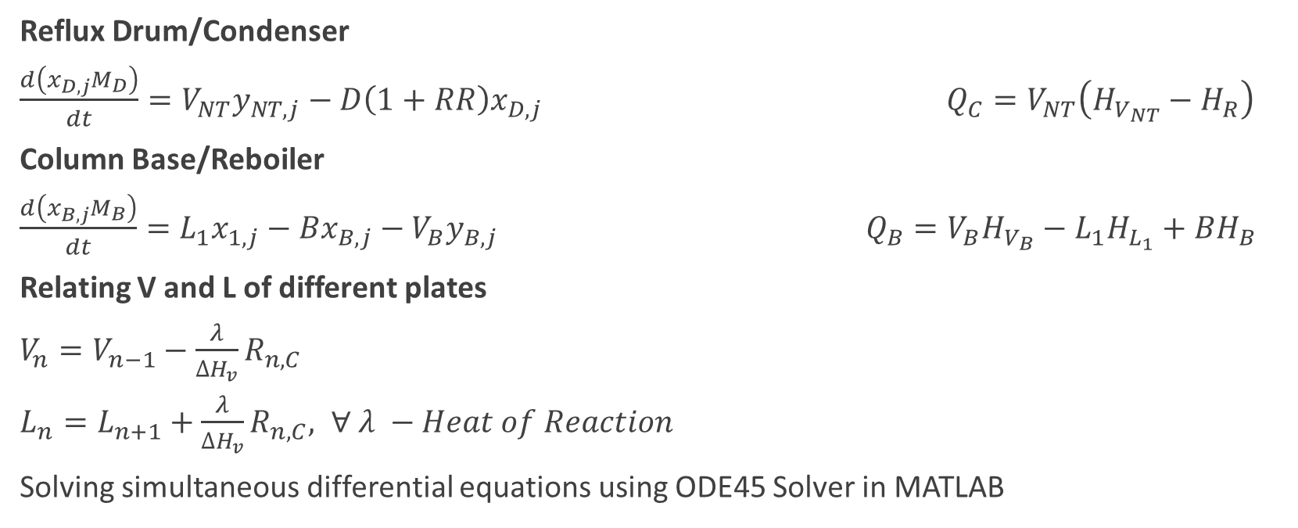
Reflux Drum/Condenser
$\frac{d\left(x_{D,j}M_{D}\right)}{dt}=V_{NT}y_{NT,j}−D\left(1+RR\right)x_{D,j}$ $Q_{C}=V_{NT}\left(H_{V_{NT}}−H_{R}\right)$
Column Base/Reboiler
$\frac{d\left(x_{B,j}M_{B}\right)}{dt}=L_{1}x_{1,j}−Bx_{B,j}−V_{B}y_{B,j}$ $Q_{B}=V_{B}H_{V_{B}}−L_{1}H_{L_{1}}+BH_{B}$
Relating V and L of different plates
$V_{n}=V_{n−1}−\frac{λ}{∆H_{v}}R_{n,C}$
$L_{n}=L_{n+1}+\frac{λ}{∆H_{v}}R_{n,C}, ∀ λ −Heat of Reaction$
Solving simultaneous differential equations using ODE45 Solver in MATLAB

Slide 8

Pre Mid – Semester Assumptions
Temperature of the column remains constant
Pressure of the Column remains constant = ${1atm}^{}$
Ideal Raoult's law ($y_{i}P_{t}=P_{i}^{sat}x_{i}$)
Mass Holdup in every tray is equal

Slide 9
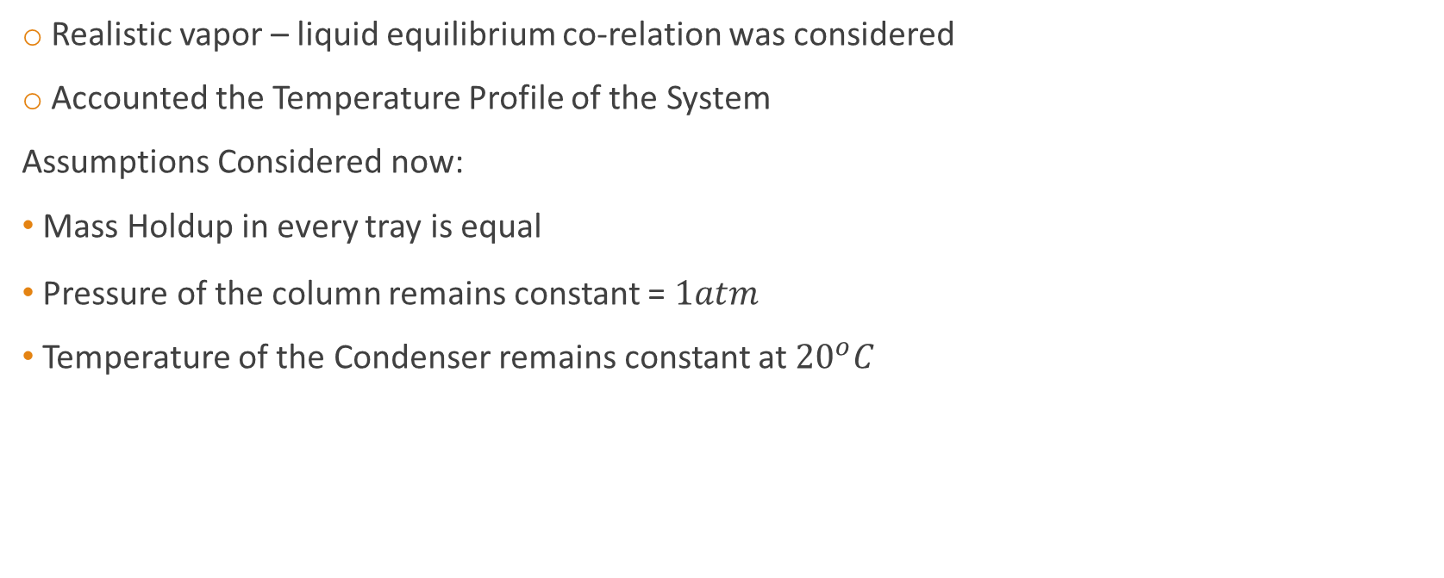
Post Mid – Semester
Realistic vapor – liquid equilibrium co-relation was considered
Accounted the Temperature Profile of the System
Assumptions Considered now:
Mass Holdup in every tray is equal
Pressure of the column remains constant = ${1atm}^{}$
Temperature of the Condenser remains constant at ${20}^{o}C$

Slide 10

1. Modified Raoult’s law
$$y_{i} z_{i}P=x_{i} γ_{i} P_{i,sat}$$
$γ,z$– Dimensionless Quantity
Expression of $γ$ derived from NRTL Model
Xu & Chuang, 1997
$$y_{i} P=x_{i} γ_{i} P_{i,sat}$$
$$\ln{γ_{i}=}\frac{\sum_{j=1}^{4}{τ_{ji}G_{ji}x_{j}}}{\sum_{l=1}^{4}{G_{li}x_{l}}}+\sum_{j=1}^{4}{\frac{x_{j}G_{i,j}}{\sum_{l=1}^{4}{G_{lj}x_{l}}}\left(τ_{ij}−\frac{\sum_{n=1}^{4}{τ_{nj}G_{nj}x_{n}}}{\sum_{l=1}^{4}{G_{lj}x_{l}}}\right)}$$
Where,
$$τ_{ji}=\frac{g_{ji}−g_{ii}}{RT}$$
$$G_{ji}=\exp\left(−α_{ji}τ_{ji}\right)$$
Note: $τ_{ii}=τ_{jj}=0$ and $G_{ii}=G_{jj}=1$

Slide 11
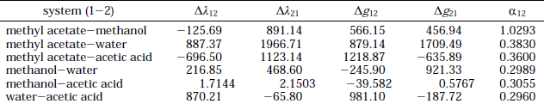
Binary Model Parameters, considering P = 760 mmHg for the system of Methyl Acetate, Methanol, Acetic Acid and Water

Slide 12
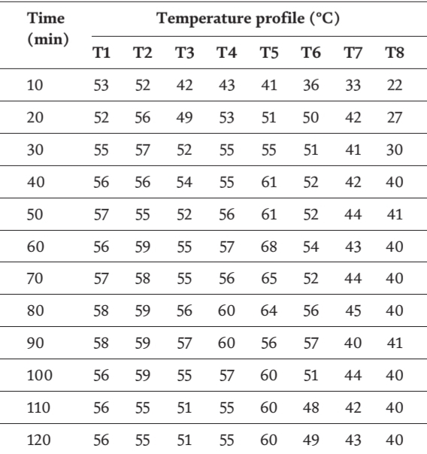
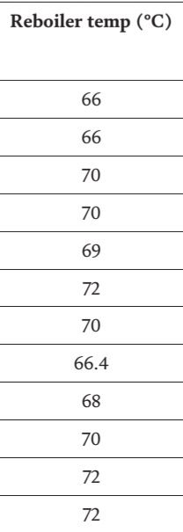
2. Temperature Variations
Hands on the data of temperature variations across the column at different time instances

Slide 13

Temperature Profile derived from Trendline
Temperature of the Condenser kept constant at ${20}^{o}C$
Difference between conventional Distillation Column and RDC

Slide 14
Results
Pre Mid-Semester Result
Post Mid-Semester Result

Slide 15
Pre Mid-Semester Result
Post Mid-Semester Result

Slide 16
Future Prospects
To optimize the results by considering to vary certain parameters like
Bottoms Rate
RR
Distillate
Pressure of the column

Slide 17
References
Fogler, H. Scott. Elements Of Chemical Reaction Engineering. Upper Saddle River, N.J. :Prentice Hall PTR, 1999.
Xu, Z. P., & Chuang, K. T. (1997). Correlation of Vapor−Liquid Equilibrium Data for Methyl Acetate−Methanol−Water−Acetic Acid Mixtures. Industrial & Engineering Chemistry Research, 36(7), 2866–2870. https://doi.org/10.1021/ie9701175
Kumar, Hemant & Arora, Shivali. (2014). Modeling of Reactive Distillation Column for the production of Ethyl Acetate. International Journal of Current Engineering and Technology. 4. 842-845.
Sakhre, Vandana. (2019). Reactive Distillation: Modeling, Simulation, and Optimization. 10.5772/intechopen.85433.
Huss, Robert & Chen, Fengrong & Doherty, Michael. (2003). Reactive distillation for methyl acetate production. Computers & Chemical Engineering. 27. 1855-1866. 10.1016/S0098-1354(03)00156-X.

Slide 18
Thankyou

